Slide 1
CHAPTER 3
Developing Project Proposals
© 2018 Cengage®. May not be scanned, copied or duplicated, or posted to a publicly accessible website, in whole or in part, except for use as permitted in a license distributed with a certain product or service or otherwise on a password-protected website or school-approved learning management system for classroom use.
Notes:
Teaching Strategies
The two vignettes reinforce the process and procedures that are not formally described in many RFPs or proposal process descriptions. Complex projects and more simple projects require the proposer to listen to the vision of the company then incorporate what was learned into the proposal. The first displays the success of developing a project proposal. The second includes failures when developing a project proposal. (See Premium Deck for Slides.)
The vignettes also reinforce the necessity to listen to the customer's need and reflect the understanding of the need, problem, or opportunity within each of the three sections of the proposal.
Optional Supplemental Activities
Have the students read the case studies in class and answer the questions in groups of three or four. Next, select five participants to act out the group activity. This is an excellent way to stimulate class discussion and interest. This is a good case study to do right before you conduct the lecture on this chapter and then repeat after you lecture on the chapter. The difference in responses “before” and “after” will reinforce the importance of the topics covered.
Try to bring real-world examples into each discussion section. Always ask the students if they can think of any examples that apply. This will help keep the class interaction high.
Ask your students if they have ever seen or written a proposal. Ask your students what is more important—developing a quality proposal or doing a quality job. Let them debate this chicken and the egg issue.
Optional Supplemental Activities
Have students review RFPs found on the web and outline a possible response. Within the outline, have the students identify the project scope. Teams could be assigned to describe the technical, management, and cost sections of the proposal.
Have students evaluate proposal writing software they find on the Web for its ability to complete the technical, management, and cost sections of the proposal. Students can rate the ease of use of the software and the learning curve necessary to learn to use the software.

Slide 2
Learning Outcomes
Develop relationships with customers and partners
Decide whether to prepare a proposal in response to a customer’s RFP
Create a credible proposal
Determine a fair and reasonable price for a proposal
Discuss how customers evaluate proposals
Explain types of contracts and various terms and conditions
Measure the success of proposal efforts
Notes:
Learning Outcomes
After studying this chapter, students should know how to:
Develop relationships with customers and partners
Decide whether to prepare a proposal in response to a customer’s RFP
Create a credible proposal
Determine a fair and reasonable price for a proposal
Discuss how customers evaluate proposals
Explain types of contracts and various terms and conditions
Measure the success of proposal efforts

Slide 3
Project Procurement Management
Project Management Knowledge Areas from PMBOK® Guide
Notes:
Project Management Knowledge Areas from PMBOK® Guide
Concepts in this chapter support the following Project Management Knowledge Areas of the PMI Guide to the Project Management Body of Knowledge (PMBOK® Guide):
Project Procurement Management

Slide 4
Building Relationships with Customers and Partners
Foundation for successful funding and opportunities
Requires good listening and constant learning
Frequent and regular contact; express appreciation for the client’s time
Trust is key and ethics are imperative
First impression is important
Problem solving and credibility grows with good performance
Partner with several key individuals in an organization
Notes:
Building Relationships with Customers and Partners
Generally speaking, customers (clients) and partner organizations prefer to work with people they know and trust.
Relationships establish the foundation for successful funding and contract opportunities.
Relationship building requires being proactive and engaged.
It requires face-to-face contacts; it cannot be done as effectively through e-mail or phone conversations.
Relationship building requires being a good listener and a good learner. When you are with clients, ask questions and listen. Make the client feel good. Empathize with their issues, whether they are business or personal.
Contacts with potential clients should be frequent and regular– not just when there is a current opportunity for funding or just before they will be issuing a RFP. During contacts, do not focus on discussing potential contract opportunities.
After meeting with a client, always express your appreciation and thank them for making the time to meet with you.
Establishing and building trust is key to developing effective and successful relationships with clients and partners. One way to foster this is to be reliable and responsive.
Ethical behavior in dealing with clients and partners is also imperative for building trust.
The first impression you make on a client is pivotal to developing a continuing and fruitful relationship.
Clients want to work with people who can solve problems, not with those who merely identify them.
Build credibility based on good performance.
Always put the client first. Clients want to be confident that any projects they undertake with the contractor will be successful, will involve a good working relationship with the contractor, and will help the clients achieve their business goals.
It is advisable not to rely on a good relationship with just one individual in a client or partner organization, but rather to build relationships with several key people in a client or partner organization, since key individuals may leave the organization while others become more influential.

Slide 5
Pre-RFP/Proposal Marketing
Begin developing the relationship before RFP is prepared
Can help client identify needs
Better position to win the contract
Develop a more clearly focused response to RFP
Pre-RFP and pre-proposal efforts are business development
No cost to the customer
Help build the relationship
Unsolicited proposals and uncompetitive contracts
Result of identified needs and problem solving
Eliminates preparation of an RFP and soliciting process
Notes:
Pre-RFP/Proposal Marketing
Contractors whose business depends on creating winning proposals in response to business or government RFPs should not wait until formal RFP solicitations are announced by customers before starting to develop proposals.
Contractors need to develop relationships with potential customers long before the customers prepare RFPs.
Contractors should maintain frequent contacts with past and current customers and initiate contacts with potential new customers.
A contractor who is familiar with a customer’s needs and requirements can prepare a better proposal in response to the customer’s RFP.
These pre-RFP or pre-proposal efforts by a contractor are considered marketing or business development and are performed at no cost to the customer.
In some cases, the contractor may prepare an unsolicited proposal and present it to the customer.
If the customer is confident that the unsolicited proposal will solve the problem at a reasonable cost, the customer may simply negotiate a contract with the contractor to implement the proposal, thus eliminating the preparation of an RFP and the subsequent competitive proposal process.
Whether the goal is winning a competitive RFP or obtaining a noncompetitive contract from a customer, a contractor’s pre-RFP/proposal efforts are crucial to establishing the foundation for eventually winning a contract from the customer to perform the project.

Slide 6
Decision to Develop a Proposal
Development is costly and time consuming
Contractors must be realistic about their probability of winning a contract
Evaluate bid/no-bid decision
Many non-winning proposals hurt reputation
May be hard to decide to no-bid an RFP
Notes:
Decision to Develop a Proposal
The development and preparation of a proposal can be costly and time-consuming.
Contractors interested in submitting a proposal must be realistic about the probability of being selected as the winning contractor.
Evaluating whether or not to go forward with the preparation of a proposal is sometimes referred to as the bid/no-bid decision.
Contractors need to be realistic about their ability to prepare proposals and about the probability of winning the contract because submitting a lot of non-winning proposals in response to RFPs can hurt a contractor’s reputation.
Sometimes the hardest thing for a contractor to do is to decide to no-bid an RFP.

Slide 7
Bid or No-Bid?
Factors to consider
Competition
Risk
Mission
Extension of capabilities
Reputation
Customer funds
Proposal resources
Project resources
Notes:
Bid or No-Bid?
Some factors that a contractor might consider in making a bid/no-bid decision are:
Competition—which other contractors might also submit a proposal?
Risk—is there a risk that the project will be unsuccessful (either technically or financially)?
Mission—is the proposed project consistent with the contractor’s business mission?
Extension of capabilities—would the proposed project provide the contractor with an opportunity to extend and enhance its capabilities?
Reputation—what is the contractor’s reputation with the customer?
Customer funds—does the customer really have funds available to go forward with the project?
Proposal resources—are appropriate resources available to prepare a quality proposal?
Project resources—are appropriate resources available to perform the project if the contractor is selected as the winner?
If a contractor is not sure that it has the resources to perform the project, it needs a plan for securing the necessary resources to successfully perform the project.

Slide 8
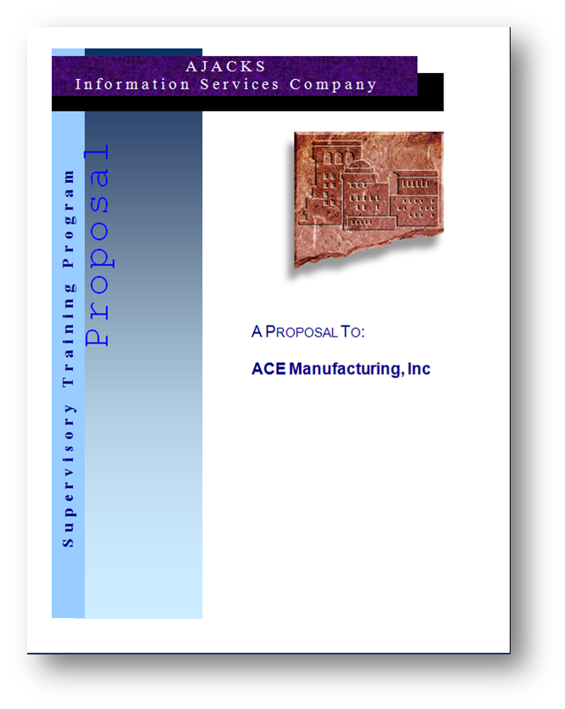
Creating a Winning Proposal
Selling document
The best idea to solve the problem
Highlight unique factors
Emphasize benefits to the customer
Be simple and concise
Addresses requirements from RFP
Be realistic
Notes:
Creating a Winning Proposal
The proposal process can be highly competitive and a proposal is a selling document - not a technical report.
In the proposal, the contractor must convince the customer that the contractor is the best one to solve the problem.
The contractor should highlight the unique factors of its proposal that differentiate it from competing contractors.
The proposal should always emphasize the benefits to the customer.
Proposals should be written in a simple, concise manner.
Proposals must be specific in addressing the customer’s requirements as laid out in the RFP.
Proposals must be realistic, in terms of the proposed scope, cost, and schedule, in the eyes of the customer.

Slide 9
Proposal Preparation
Proposal team
Can be one person or many
Various skills and expertise
Proposal manager for large proposals
Proposal development
Time for writing, review, and management approval
Length dependent upon the RFP requirements
Cost of proposal development is part of normal business costs
Notes:
Proposal Preparation
The preparation of a proposal can be a straightforward task performed by one person, or it can be a resource-intensive effort requiring a team of organizations and individuals with various expertise and skills.
In large scale efforts, the contractor may designate a proposal manager who coordinates the efforts.
The proposal schedule must allow adequate time for writing, review, and approval by the management of the contractor’s organization.
Proposals in response to RFPs can be as brief as a few pages or as long as hundreds of pages, including text and drawings.
Customers do not pay contractors to prepare proposals. Contractors absorb the costs of proposal development as part of normal marketing costs.

Slide 10
Proposal Contents
Three sections
Technical
Management
Cost
Detail level
Depends on complexity of the project
Requirements from the RFP
Notes:
Proposal Contents
Proposals are often organized into three sections:
Technical
Management
Cost
The amount of detail the contractor includes will depend on the complexity of the project and the requirements stipulated by the RFP.

Slide 11

Technical Section
Understand the need
Proposed approach or solution
Benefits to the customer
Notes:
Technical Section
The objective of this section is to convince the customer that the contractor understands the problem or need and can provide the least risky and most beneficial solution. The technical section should contain the following elements:
Understanding of the need—the contractor must show the customer that they thoroughly understand the problem to be solved.
Proposed approach or solution—the proposal should describe the approach or methodology that would be used in developing the solution.
Benefits to the customer—the contractor should state how the proposed solution or approach would benefit the customer and achieve the project’s success criteria or expected outcomes, including cost savings; reduced processing time; reduced inventory; better customer service; reduced errors; improved safety conditions; more timely information; reduced maintenance, etc.

Slide 12

Management Section
Description of major tasks
Deliverables
Project schedule
Project organization
Related experience
Equipment and facilities
Notes:
Management Section
The objective of the management section is to convince the customer that the contractor can do the proposed work and achieve the intended results. The management section should contain the following elements:
Description of major tasks—the contractor should define the major tasks that will be performed in carrying out the project.
Deliverables—the contractor should include a list of all deliverables that will be provided during the project (such as reports, drawings, manuals, and equipment).
Project schedule—the contractor should provide a schedule for performing the major tasks required to complete the project.
The task schedule can be given in any one of several formats: a list of tasks with their estimated start and completion dates, a Gantt chart, or a network diagram.
Project organization—the contractor should describe how the work and resources will be organized to perform the project.
An organization chart, resumes of the key people, and a responsibility matrix are often helpful.
Related experience—the contractor should provide a list of similar projects it has completed and the dollar value of those contracts.
Equipment and facilities—the contractor may want to provide a list of the equipment and special facilities it has in order to convince the customer that it possesses the necessary resources.

Slide 13

Cost Section
Include estimated costs
Labor
Materials
Equipment
Facilities
Subcontractors and consultants
Travel
Documentation
Overhead
Escalation
Reserve
Fee or profit
Notes:
Cost Section
The objective of the cost section of the contractor proposal is to convince the customer that the contractor’s costs for the proposed project are realistic and reasonable. The cost section usually consists of tabulations of the contractor’s estimated costs for such elements as the following:
Labor—the estimated costs for the various classifications of people who are expected to work on the project
It might include the estimated hours and hourly rate for each person or classification.
Materials—the cost of materials the contractor needs to purchase for the project
Equipment— the cost of equipment that must be purchased to complete the project
Facilities—sometimes the contractor will have to rent special facilities or specialty space for the project team.
Subcontractors and consultants—when contractors do not have the expertise or resources to do certain project tasks, they may outsource some of the work to subcontractors or other consultants.
Travel—such as airfare, lodging, and meals if trips are required during the project
Documentation—some customers want the contractor to show separately the costs associated with the project documentation deliverables.
This would be the cost of printing manuals, drawings, reports, or the cost of DVDs.
Overhead—contractors will add a percentage to costs of the above items to cover the indirect costs of doing business (such as insurance, depreciation, accounting, general management, marketing, and human resources).
Escalation—for large projects that are expected to take several years to complete, the contractor needs to include the costs of escalation in wage rates and materials costs over the length of the project.
Reserve—the reserve (also referred to as contingency reserve or management reserve) is an amount the contractor may want to include to cover unexpected items that have been overlooked.
Fee or profit— all the above items are costs. The contractor must add an amount for its fee or profit.
The total cost plus the contractor’s fee is the contractor’s price for the proposed project.
Cost estimates should be reasonable and realistic. If possible, it is good practice to have the person who will be responsible for the major work tasks estimate the associated costs.

Slide 14
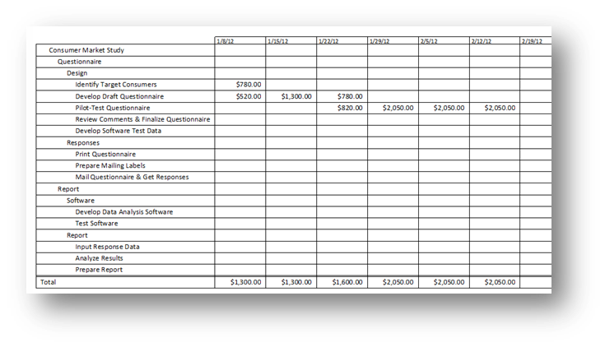
Pricing Considerations
Competition
Price
Not overpriced or underpriced
Factors
Reliability of cost estimates
Risk
Value of project to the contractor
Customer’s budget
Competition level
Notes:
Pricing Considerations
When contractors prepare a proposal, they are generally competing with other contractors. There are three main factors that contractors should consider when setting a price for a proposal: competition, prices compared to competitors, and other factors like risk and the customer’s budget.
Contractors need to be careful not to overprice the proposed project, or else the customer may select a lower-priced contractor.
They must be equally careful not to underprice the proposed project; otherwise, the contractor may lose money.
The contractor must consider the following items when determining the price for the proposed project:
Reliability of the cost estimates—the level of confidence that the total cost for the proposed project is complete and accurate
Risk - if the proposed project involves an endeavor that has not been undertaken before, it may be necessary to include a large amount of contingency funds.
Value of the project to the contractor—there may be situations in which the contractor is willing to live with a low price.
For example, in order to get a contract so it will not have lay off workers.
Customer’s budget—a proposal should not exceed what the customer has available.
Competition—if many contractors are expected to submit, it may be necessary to submit a price that includes only a small profit to increase the chances of winning the contract.

Slide 15
Simplified Project Proposal
Complex
Simplified
Large number of pages
Defined sections
Charts and figures
Tables of information
Statement of the customer’s need
Assumptions
Project scope
Deliverables
Resources
Schedule
Price
Risks
Expected benefits
Notes:
Simplified Project Proposal
Sometimes a proposal is complex for a large multi-million dollar project. These proposals will be lengthy, with many defined sections, charts, figures and tables.
At other times, the proposal may not need to be complex. A simplified or basic proposal may be appropriate and sufficient.
All proposals should include the following elements as a minimum:
Statement of the customer's need— should clearly describe the contractor's understanding of the customer's need or problem and reference any information or data to support the need
Assumptions– state any assumptions that may affect the contractor’s scope, schedule, or price
Project scope— describe the contractor’s approach to addressing the customer’s need or solving the problem, define specifically what work tasks the contractor proposes to do, and outline how the contractor expects the customer to be involved throughout the project
Deliverables— list all the tangible products or items it will provide to the customer during the performance of the project
Resources— types of expertise and skills that the contractor will utilize on the project, including any key subcontractors, consultants, or suppliers
Schedule— list of key milestones with their target dates or cycle time from the start of the project in sufficient detail to demonstrate a well-thought-out plan
Price— indicate the bottom-line price to perform the project. Emphasize the value provided and not on how low, or “cheap,” the price is.
Risks—identify potential concern about any risks that have a high likelihood of occurrence or a high degree of potential impact. Try to demonstrate that the contractor has experience with these risks and outline a realistic approach to dealing with them in the project.
Expected benefits— pull together information from the preceding sections and make a case to justify the “value” of the proposal in terms of expected quantitative benefits, such as return on investment, payback, cost savings, an increase in productivity, reduced processing times, faster time-to-market, and so on.
The focus of the proposal should be on quality of the content—clear, concise, and convincing—rather than quantity or number of pages.
Many simplified project proposals range from 4 to 8 pages, and they are usually less than 20 pages.
It is appropriate to attach appendices for items such as resumes of key people who will be assigned to the project, back-up details for cost estimates, or a list of past related projects and associated references.

Slide 16
Proposal Submission and Follow-up
Submission
Follow-up
On time
Formatted properly
Sent in manner required
Hard copies
E-mail
Electronic form
Two sets by different delivery methods
Be proactive
Professional manner
Follow RFP guidelines
Notes:
Proposal Submission and Follow-up
Proposals should be:
Submitted on time
Late or incomplete proposals are often not accepted
Formatted properly
In the manner specified
Possibly deliver two sets by different delivery methods
Depending on the dollar value of the proposal, some contractors have been known to hand-deliver the proposal or send two sets of proposals by different express mail services.
Contractors must continue to be proactive even after the proposal is submitted.
Any follow-up needs to be done in a professional manner and in accordance with the RFP guidelines.

Slide 17
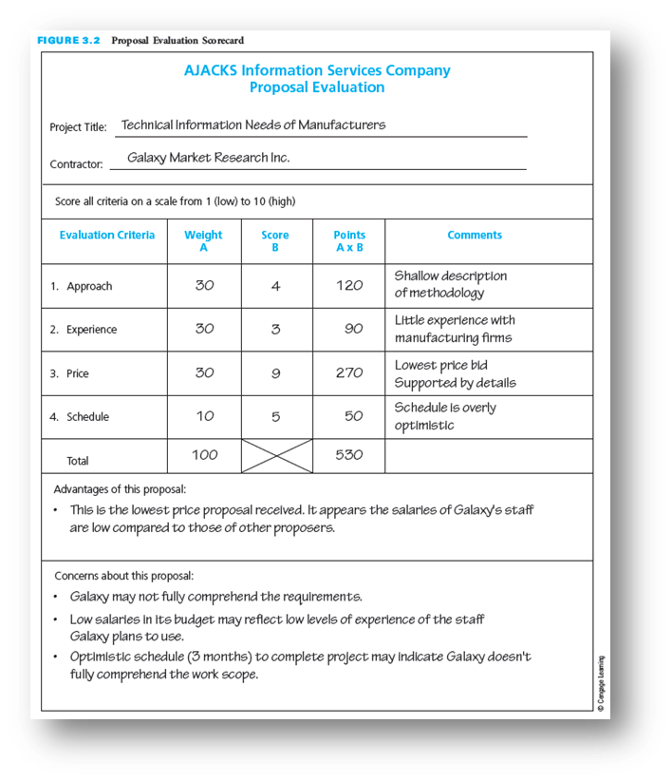
Customer Evaluation of Proposals
Customer sets criteria
Customer may request a best and final offer (BAFO)
Helps to have common comparison criteria
Notes:
Customer Evaluation of Proposals
Customers evaluate contractors’ proposals in many different ways.
Some customers first look at the prices and select only the three lowest-priced proposals for further evaluation.
Some screen out proposals with prices above their budget or those whose technical section does not meet all the requirements.
Others, especially on large projects, create a proposal review team that uses a scorecard to rate each proposal.
The figure above depicts a proposal evaluation scorecard. Have the students review the proposal evaluation scorecard and make suggestions of what could be done to raise the scores for the proposal submission.
The scorecard can be a valuable tool because it helps to have uniform comparison criteria for different proposals.

Slide 18
Contracts
Agreement
Types
Contract must be signed before starting work
Establishes communication
Agreement of deliverables for a certain price
Fixed Price
Price remains fixed
Low risk for customer
High risk for contractor
For well-defined projects with little risk
Cost-Reimbursement
Price for actual costs
High risk for customer
Low risk for contractor
For higher risk projects
Notes:
Contracts
Just because the contractor has been selected as the winner does not mean the contractor begins the work right away. Before the project can proceed, a contract must be signed between the customer and the contractor.
A contract is a vehicle for establishing good customer-contractor communications and arriving at a mutual understanding and clear expectations to ensure project success.
It is an agreement between the contractor, who consents to provide a product or service (deliverables), and the customer, who agrees to pay the contractor a certain amount in return.
The contract must clearly spell out the deliverables the contractor is expected to provide.
There are basically two types of contracts: fixed price and cost reimbursement.
In a fixed-price contract, the customer and the contractor agree on a price for the proposed work.
The price remains fixed unless the customer and contractor agree on changes.
This type of contract is low risk for the customer, since the customer will not pay more than the originally agreed-upon price.
This type of contract is high risk for the contractor because, if the cost of completing the project is more than originally planned, the contractor will make a lower profit than anticipated— or may even lose money.
Fixed-price contracts are most appropriate for projects that are well defined and entail little risk.
In a cost-reimbursement contract, the customer agrees to pay the contractor for all actual costs (labor, materials, and so forth), regardless of amount, plus some agreed-upon profit.
This type of contract is high risk for the customer, since contractor costs can overrun the proposed price.
In cost-reimbursement contracts, the customer usually requires that, throughout the project, the contractor regularly compare actual expenditures with the proposed budget and reforecast cost-at-completion.
This type of contract is low risk for the contractor because all costs will be reimbursed by the customer. The contractor cannot lose money on this type of contract.
Cost-reimbursement contracts are most appropriate for projects that involve a higher degree of risk.

Slide 19
Contract Terms and Conditions
Misrepresentation of costs
Notice of cost overruns or schedule delays
Approval of subcontractor
Customer furnished equipment of information
Patents
Disclosure of proprietary information
International considerations
Termination
Terms of payments
Bonus/penalty payments
Changes
Notes:
Contract Terms and Conditions
The following are some of the terms and conditions that are commonly included in project contracts:
Misrepresentation of costs—states that it is illegal for the contractor to overstate the hours or costs expended on the project
Notice of cost overruns or schedule delays—outlines the circumstances under which the contractor must notify the customer of any schedule delays
Approval of subcontractor—indicates when the contractor needs to obtain approval before hiring a subcontractor
Customer-furnished equipment or information—lists the items that the customer will provide to the contractor throughout the project and the dates by which the customer will make these items available
Patents—covers ownership of patents that may result from conducting the project
Disclosure of proprietary information—prohibits one party from disclosing confidential information, technologies, or processes pertaining to the project
International considerations—specifies accommodations that must be made for customers from other countries
Termination—states the conditions under which the customer can terminate the contract, such as nonperformance by the contractor
Terms of payment—addresses the basis on which the customer will make payments to the contractor
Bonus/penalty payments—some contracts have a bonus provision, wherein the customer will pay the contractor a bonus if the project is completed ahead of schedule or exceeds other customer performance requirements
On the other hand, some contracts include a penalty provision, wherein the customer can reduce the final payment to the contractor if the project is not completed on schedule or if performance requirements are not met.
Changes—Covers the procedure for proposing, approving, and implementing changes to the project scope or schedule

Slide 20
Measuring Proposal Success
Measures
Strategies
Win ratio
Number won/number submitted
All proposals weighted equally
Total dollar value
Value won/value submitted
More weight to larger values
Submit many to win fair share
Increase chances of winning
May be viewed negatively
Bid on potential successes
Respond where better than average chance to win
Must have bid/no-bid process
Notes:
Measuring Proposal Success
Contractors measure the success of their proposal efforts by the number of times their proposals are selected by customers or by the total dollar value of their proposals that are selected.
Win ratio: The percentage of the number of proposals a contractor won out of the total number of proposals the contractor submitted to various customers over a particular time period; gives equal weight to all proposals.
Total dollar value: Total dollar value of proposals that the contractor won as a percentage of the total dollar value of all the proposals the contractor submitted to various customers during a specific time period; gives more weight to proposals with larger dollar amounts.
Some contractors have a strategy of submitting proposals in response to as many RFPs as they can with the hope that they will eventually win their fair share. Their philosophy is that if they do not submit a proposal then they do not have any chance to win and by submitting more proposals they increase their chances of winning more contracts.
Other contractors are more selective in submitting proposals; they respond to only those RFPs where they think they have a better-than-average chance of winning the contract. These contractors seriously consider the bid/no-bid decision process in responding to RFPs and submit fewer proposals in an attempt to have a high win ratio.

Slide 21
Critical Success Factors
Customers and partner organizations prefer to work with people they know and trust. Relationships establish the foundation for successful funding and contract opportunities.
Establishing and building trust is key to developing effective and successful relationships with clients and partners.
The first impression one makes on a client is pivotal to developing a continuing and fruitful relationship.
Pre-RFP/proposal efforts are crucial to establishing the foundation for eventually winning a contract from the customer.
Do not wait until formal RFP solicitations are announced by customers before starting to develop proposals. Rather, develop relationships with potential customers long before they prepare their RFPs.
Working closely with a potential customer puts a contractor in a better position to be selected as the winning contractor. Learn as much as possible about the customer’s needs, problems, and decision-making process during pre-RFP/proposal marketing.
Notes:
Critical Success Factors
Customers and partner organizations prefer to work with people they know and trust. Relationships establish the foundation for successful funding and contract opportunities.
Establishing and building trust is key to developing effective and successful relationships with clients and partners.
The first impression one makes on a client is pivotal to developing a continuing and fruitful relationship.
Pre-RFP/proposal efforts are crucial to establishing the foundation for eventually winning a contract from the customer.
Do not wait until formal RFP solicitations are announced by customers before starting to develop proposals. Rather, develop relationships with potential customers long before they prepare their RFPs.
Working closely with a potential customer puts a contractor in a better position to be selected as the winning contractor. Learn as much as possible about the customer’s needs, problems, and decision-making process during pre-RFP/proposal marketing.

Slide 22
Critical Success Factors (continued)
Becoming familiar with the customer’s needs, requirements, and expectations will help in preparing a more clearly focused proposal.
Be realistic about the ability to prepare a quality proposal and about the probability of winning the contract. It is not enough just to prepare a proposal; rather, the proposal must be of sufficient quality to have a chance of winning.
A proposal is a selling document, not a technical report. It should be written in a simple, concise manner and should use terminology with which the customer is familiar.
In a proposal, it is important to highlight the unique factors that differentiate it from competitors’ proposals.
Proposals must be realistic. Proposals that promise too much or are overly optimistic may be unbelievable to customers, and may raise doubt about whether the contractor understands what needs to be done or how to do it.
When bidding on a fixed-price project, the contractor must develop accurate and complete cost estimates and include sufficient reserve.
Notes:
Critical Success Factors (continued)
Becoming familiar with the customer’s needs, requirements, and expectations will help in preparing a more clearly focused proposal.
Be realistic about the ability to prepare a quality proposal and about the probability of winning the contract. It is not enough just to prepare a proposal; rather, the proposal must be of sufficient quality to have a chance of winning.
A proposal is a selling document, not a technical report. It should be written in a simple, concise manner and should use terminology with which the customer is familiar.
In a proposal, it is important to highlight the unique factors that differentiate it from competitors’ proposals.
Proposals must be realistic. Proposals that promise too much or are overly optimistic may be unbelievable to customers and may raise doubt about whether the contractor understands what needs to be done or how to do it.
When bidding on a fixed-price project, the contractor must develop accurate and complete cost estimates and include sufficient contingency costs.

Slide 23
Summary
Interested contractors develop proposals in response to a customer’s RFP.
Relationships establish the foundation for successful funding and contract opportunities. Relationship building requires being proactive and engaged.
Contractors should develop relationships with potential customers long before customers prepare an RFP.
Because the development and preparation of a proposal take time and money, contractors interested in submitting a proposal in response to an RFP must be realistic about the probability of being selected as the winning contractor.
It is important to remember that the proposal process is competitive and that the proposal is a selling document that should be written in a simple, concise manner. In the proposal, the contractor must highlight the unique factors that differentiate it from competing contractors.
Proposals are often organized into three sections: technical, management, and cost.
Customers evaluate contractors’ proposals in many different ways.
Once the customer has selected the winning contractor, the contractor is informed that it is the winner, subject to successful negotiation of a contract: fixed-price and cost reimbursement are the two types of contracts.
Contractors measure the success of their proposal efforts by the number of times their proposals are selected by customers and/or by the total dollar value of their proposals that are selected.
Notes:
Summary
Interested contractors develop proposals in response to a customer’s RFP.
Relationships establish the foundation for successful funding and contract opportunities. Relationship building requires being proactive and engaged.
Contractors should develop relationships with potential customers long before customers prepare an RFP.
Because the development and preparation of a proposal take time and money, contractors interested in submitting a proposal in response to an RFP must be realistic about the probability of being selected as the winning contractor.
It is important to remember that the proposal process is competitive and that the proposal is a selling document that should be written in a simple, concise manner. In the proposal, the contractor must highlight the unique factors that differentiate it from competing contractors.
Proposals are often organized into three sections: technical, management, and cost.
Customers evaluate contractors’ proposals in many different ways.
Once the customer has selected the winning contractor, the contractor is informed that it is the winner, subject to successful negotiation of a contract: fixed-price and cost reimbursement are the two types of contracts.
Contractors measure the success of their proposal efforts by the number of times their proposals are selected by customers and/or by the total dollar value of their proposals that are selected.

